Slide 1
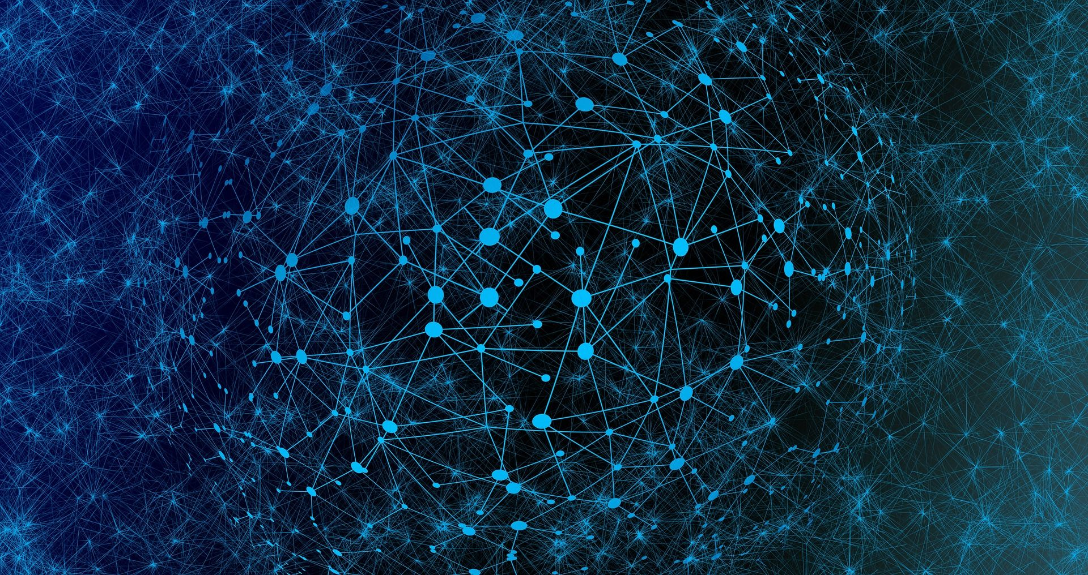

중간발표
김현우
신정민
한재혁
곽지훈
Network Science Lab
The Catholic University of Korea
E-mail : kimwoohyun0622@gmail.com

Slide 2
Contents
1.Basic concept of Deep learning
2.Introduction of graph
3.Application of graph
1.KG in medical domain
2.molecular learning

Slide 3
Basic concept of Deep learning

Slide 4
Deep learning is the branch of machine learning
History of DL is from 1958, perceptron.
Most of these day’s AI is mostly Deep Learning
NLP, CV, biology, chemistry…. Even Math DL is becoming powerful monster in this era
Then… what is difference with the others?

Slide 5
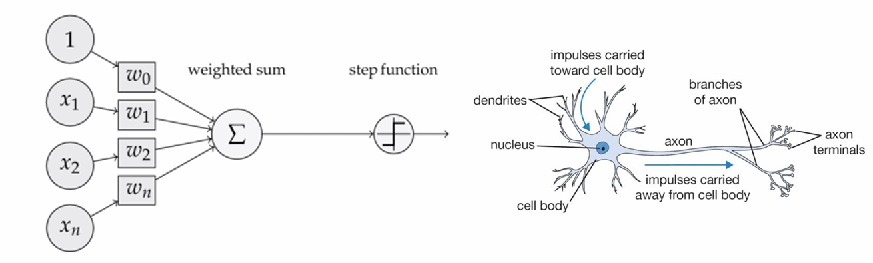
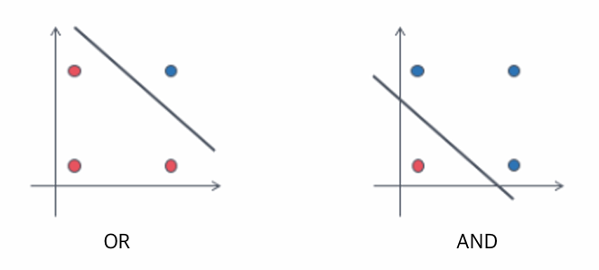
The origin of Deep Learning is based on approximation theory
Inspired by neuron, perception accept inputs, if weighted summation of input is over the threshold then put out 1.
By this function we can express OR, AND operators and the other…..

Slide 6
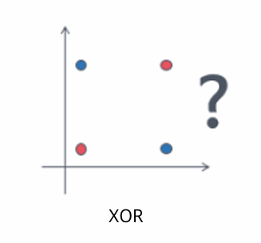
But 1969, Marvin Minsky prove perceptron function can’t solve XOR problem.

Slide 7
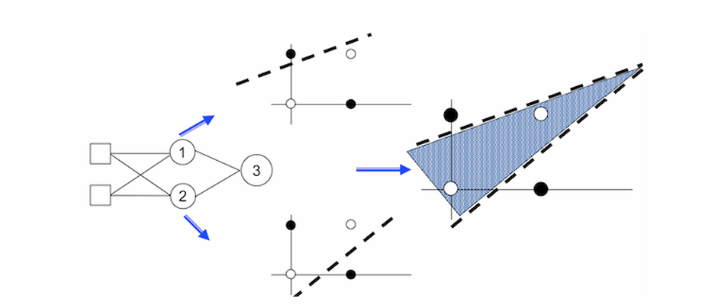
But by stack two layer, we can express XOR operator by using only perceptron.
1989, George cybenko prove perceptrons with sigmoid function can approximate all continuous function.

Slide 8
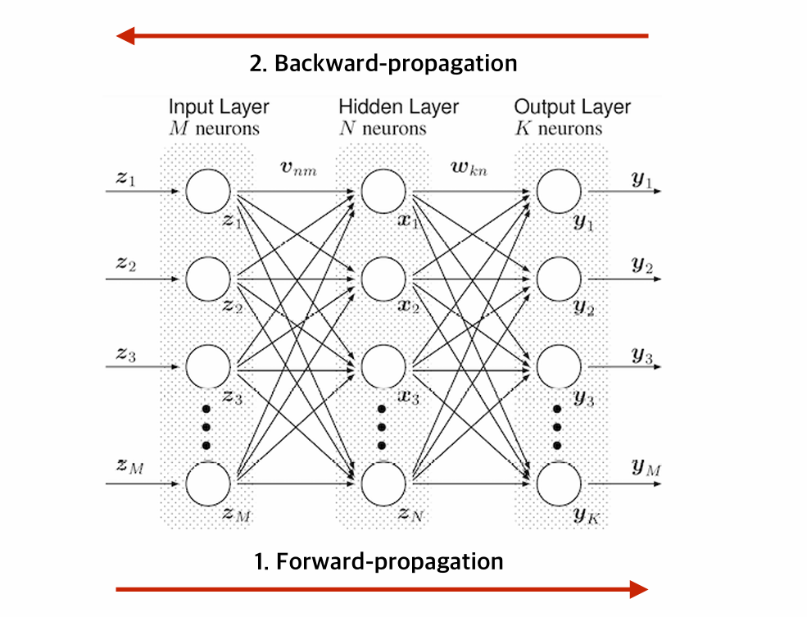
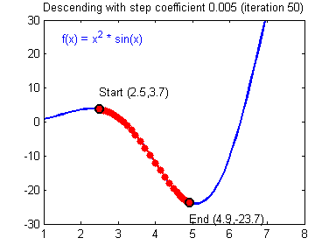

Slide 9
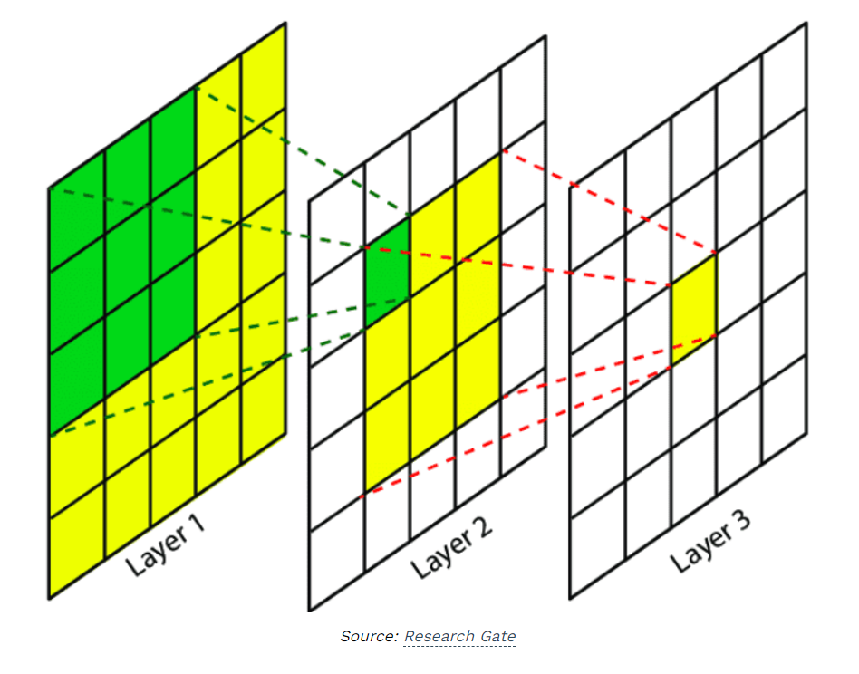
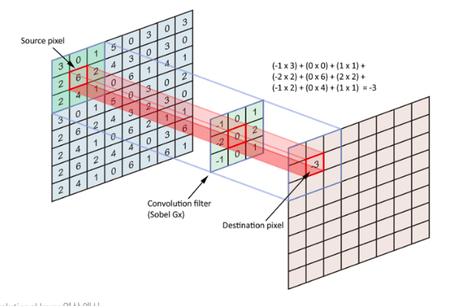

Slide 10
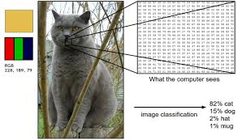


Slide 11
Graph

Slide 12
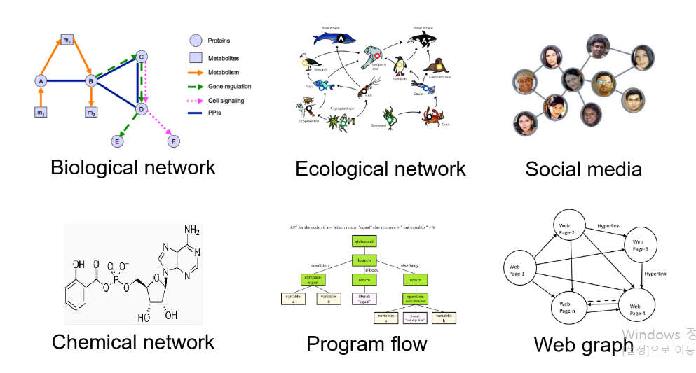
Graph is universal expression of our world.
Social network
Chemical network
Citation network….
Even image, language data also can be expressed as a graph structure
Recent year, Graph became most fruitful expression of this era data

Slide 13
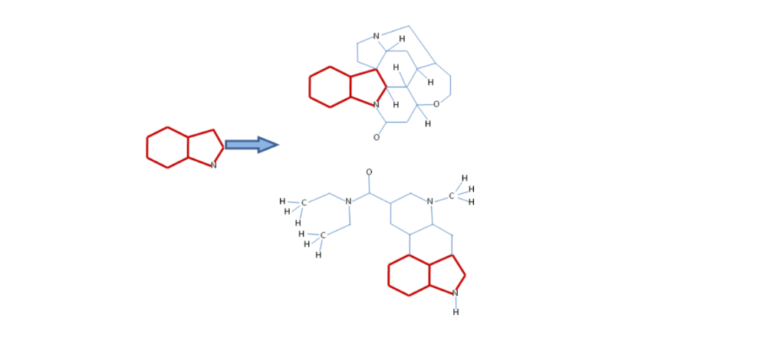
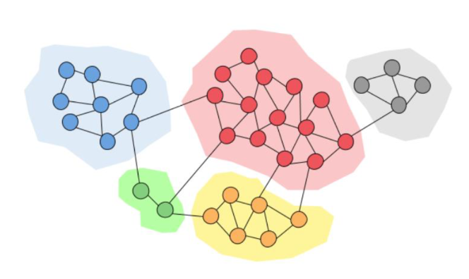
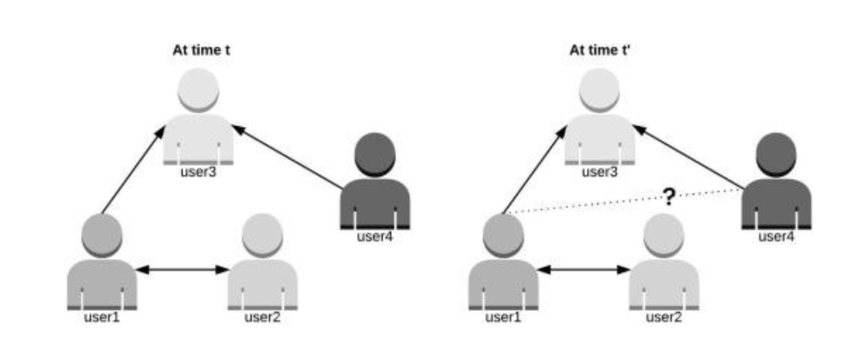
Graph’s task is divided by three part.
Graph level
E.g. Predict molecular property
Node level
E.g. Predict user’s abnormality
Edge level
E.g. Predict relation between two entity

Slide 14
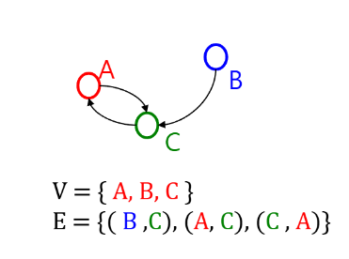
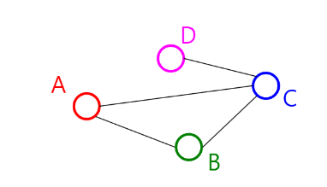
Starting point of graph is pure mathematics
Terminology is from graph theory
Network = Graph
Nodes = Vertices = Actors = Entities
Links = Edges = Relations
Clusters = Communities
Graph is divided by two type
Undirected
When graph has no directions
Directed
When graph has directions

Slide 15
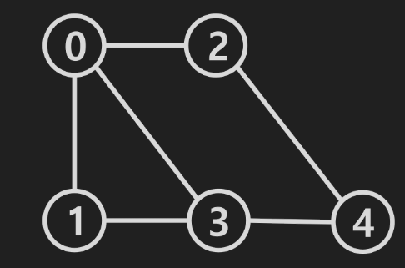
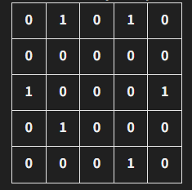
Unlike the images and languages, graph had difficulty about applying on neural network
Unlike with Images, graph is not fixed size
Can’t apply CNN
Unlike with languages, graph don’t have order
Can’t apply RNN
Before spatial GNN suggested, dominant method based on fourier transformation
Transform Laplacian matrix, make learnable Filter
Too big complexity
If the graph is different, is not work

Slide 16
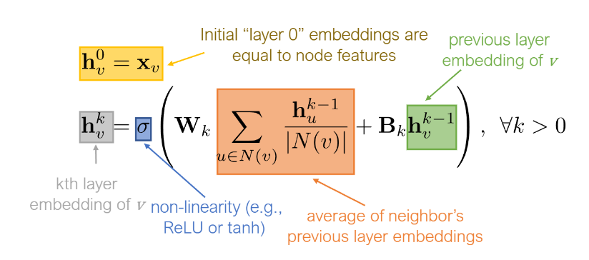
In CNN, pixel’s property is decided by their adjacent pixels
Similar with CNN, property of node is decided by their adjacent nodes
We call this property as Homophiliy
This is crucial idea of GNN
Inspired by this, MESSAGE PASSING mechanism was suggested
Aggregate adjacent information of nodes
Update their information

Slide 17
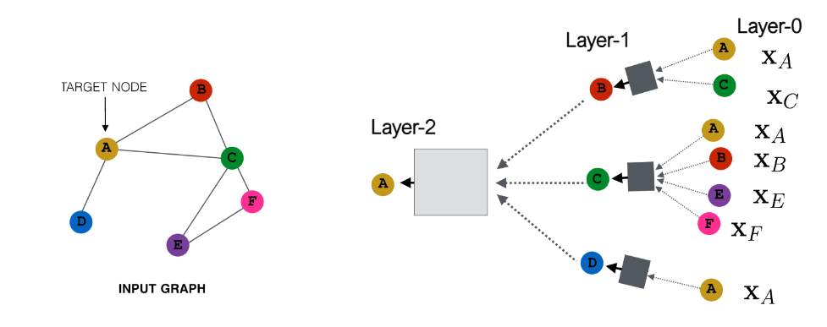
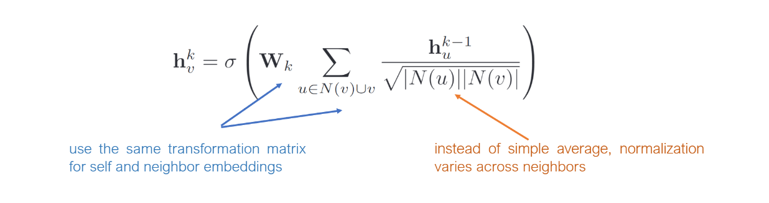

Slide 18
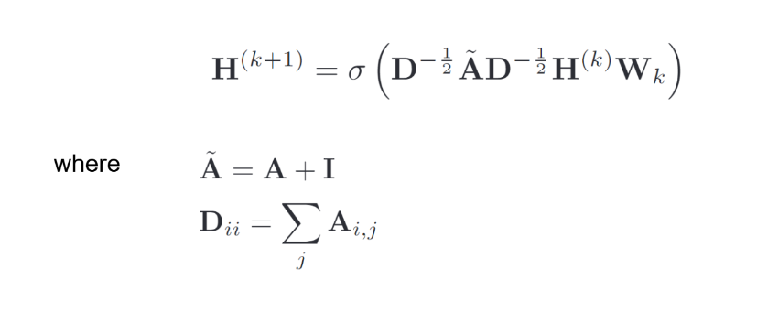

Slide 19
Knowledge Graph
In Medical domain

Slide 20
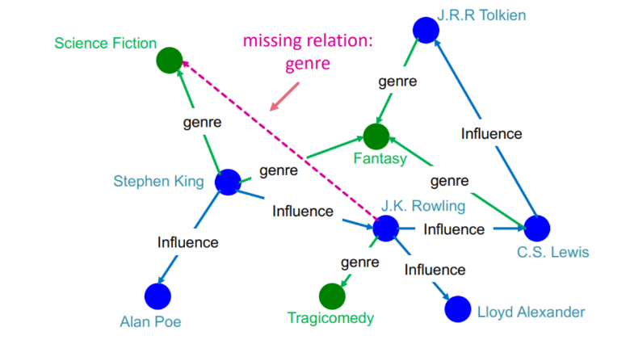
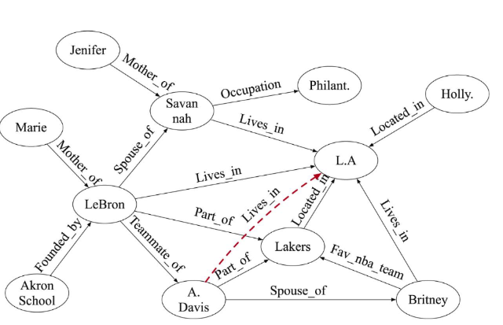
Knowledge graph is form of Knowledge as a graph
Over the specific domain, KG express every entity in this world
KG formed by two element
Entity
relation

Slide 21
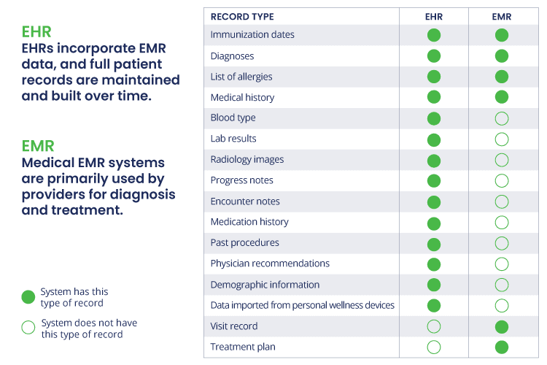
EMR data is the record that serve demographic, diagnosis, prescription, test information .etc
It is useful when medical staff make a decision.
Recent year, a lot of paper try to make diagnostic AI based on EMR data
But EMR data alone does not provide sufficient information for AI

Slide 22
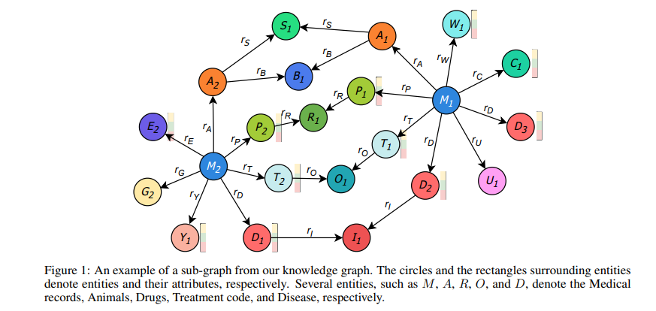
To make sufficient information for AI, there are solutions
Convert EMR data to sequential form which can serve timeline information
Extract feature by LLM can serve descriptional information
Construct KG can serve topological information

Slide 23
Topological information, it is very crucial factor of diagnosis
Patient who have cough and who have cough with hemoptysis are different.
Patient who have tumor and who have tumor with family history are different.
This example is very simple. But in real world, not only 2 but also 10, 20, 100…. Case exist
We can easily express complex structure as a graph.
We can easily predict what disease patient have from graph.

Slide 24
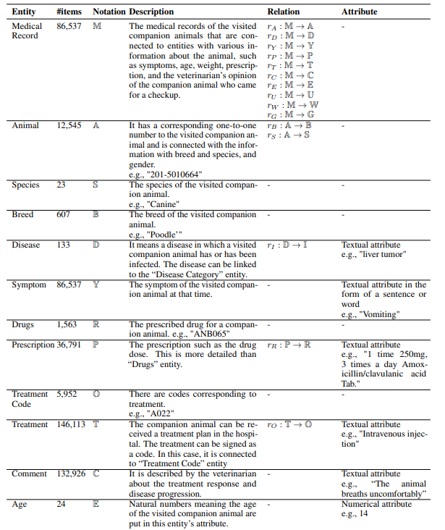
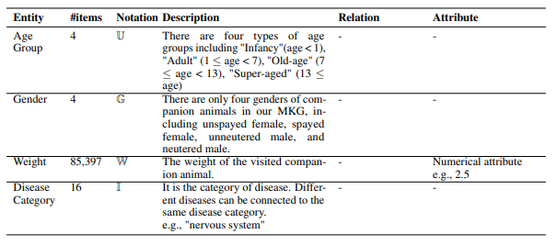
In this paper, they propose the model, Literal KG that predict animal diseases.
They use not only symptoms data but also species, breed, drug .etc

Slide 25
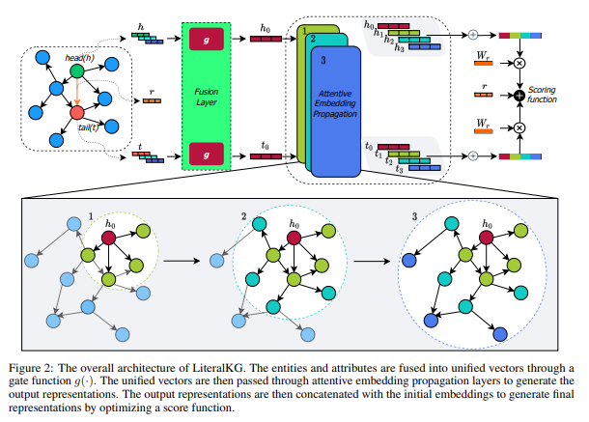

Slide 26
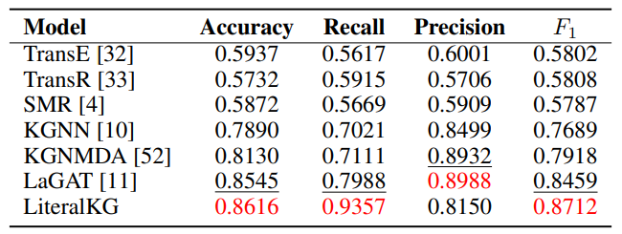

Slide 27
In medical domain, hallucination issue is very critical.
LLM is clumsy at capturing factual knowledge
Recent year, the lying issue is solving but still here.
Why the issue occur is from LLM’s mechanism
Language is not a fact. It is description of fact.
LLM just capture language’s pattern. Not a pattern of fact
How can we solve this problem?
Use KG which is FACT itself.

Slide 28
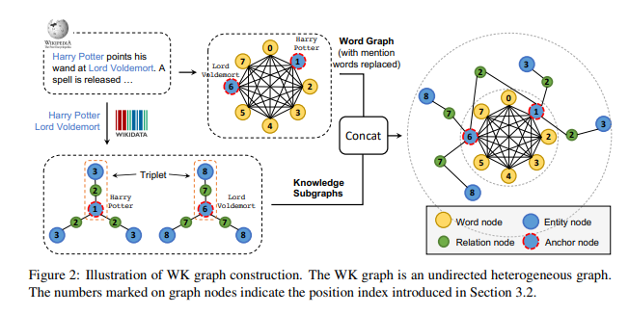
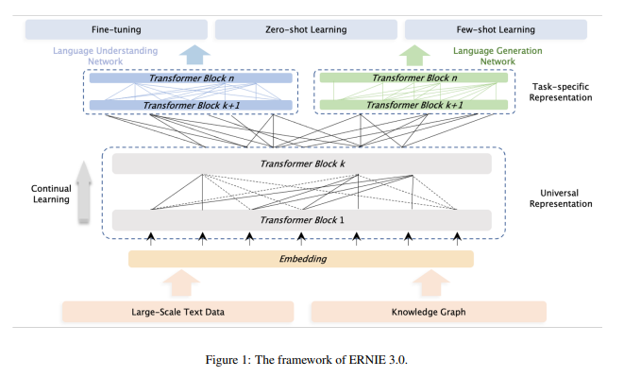
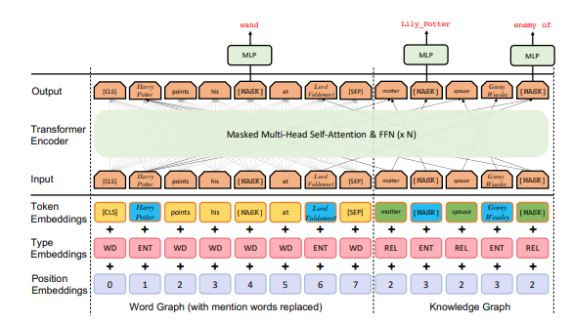

Slide 29
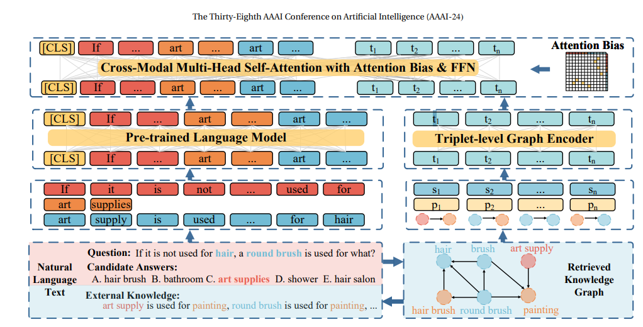
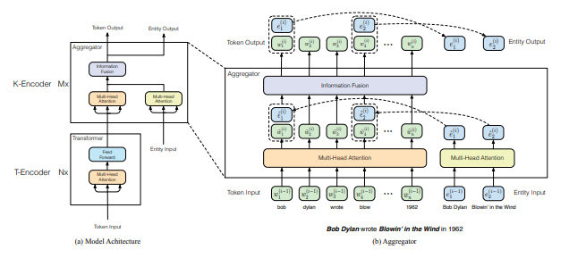
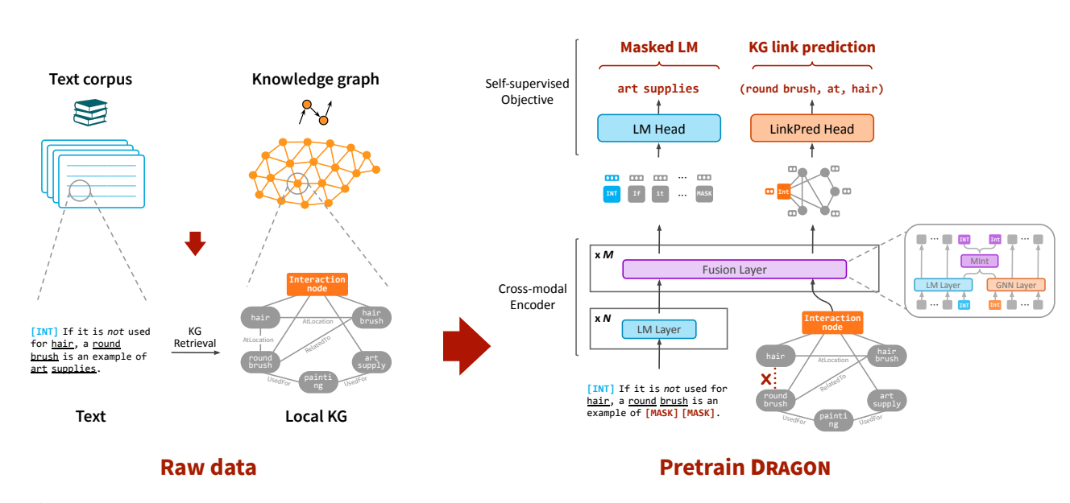

Slide 30
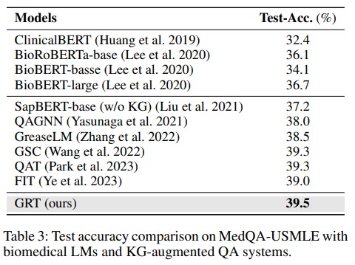

Slide 31
Molecular Learning

Slide 32
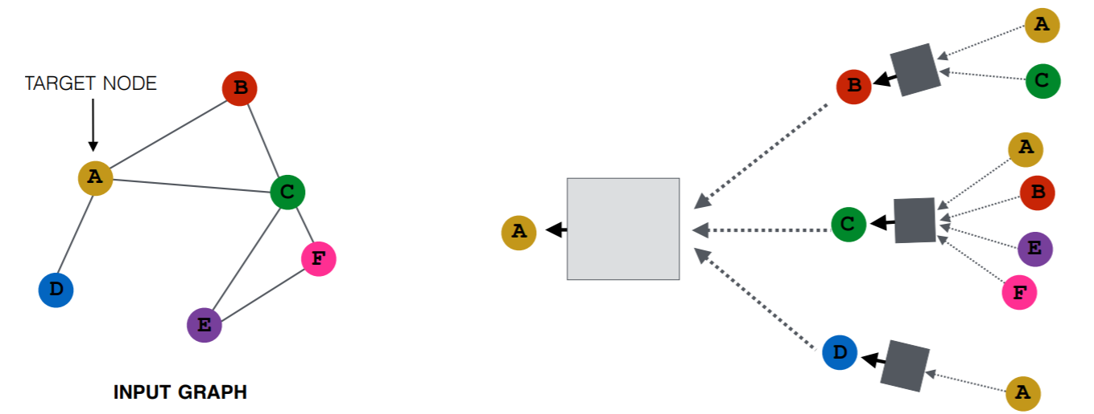
Recap: Graph Convolutional Networks (GCNs)
Key Idea: Each node aggregates information from its neighborhood to get contextualized node embedding.
Limitation: Most GNNs focus on homogeneous graph.
Aggregate neighbor’s information
Neural Transformation

Slide 33
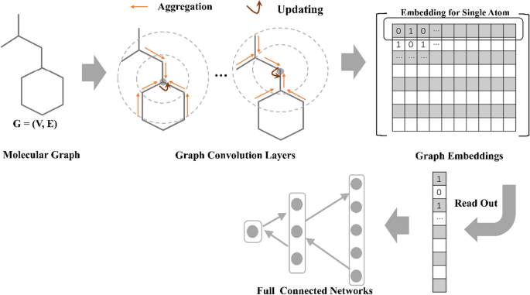
Recap: Graph data as molecules
Molecules can be naturally represented as graphs with their atoms as nodes and chemical bonds as edges. Graph data such as molecules and polymers are found to have attractive properties in drug and material discovery
Molecules as graphs

Slide 34
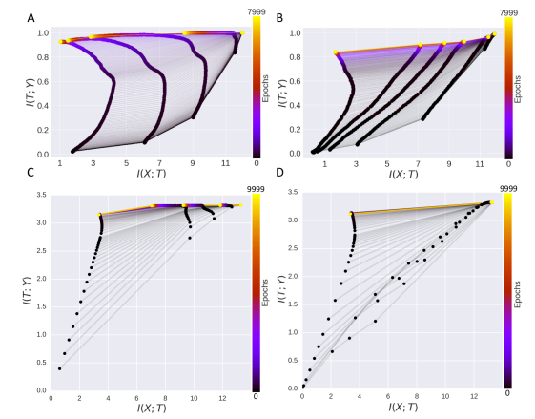
Recap: Information bottleneck principle
In perspective of Information bottleneck principle, Deep learning model can be defined by extraction and compression phase.
early phase of epoch, DL extract information that related with target Y from input X
Late phase of epoch, DL compress information that is not related with Y from input X
It can be summurized
“DL learning is process that removing irrelavant information with target Y from input X”

Slide 35
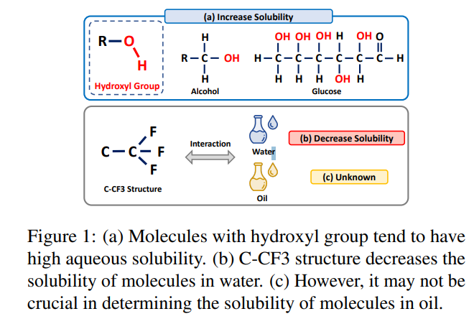
Relational learning
When molecule interact with other molecule. Not entire chemical structure participate in a reaction. but Few substructure make a reaction and their own property. And we call this substructure, Functional group.
But previous work, a lots of paper utilizing entire molecule structure to predict reaction. Because of that, previous model have poor generalizablilty and performance.

Slide 36
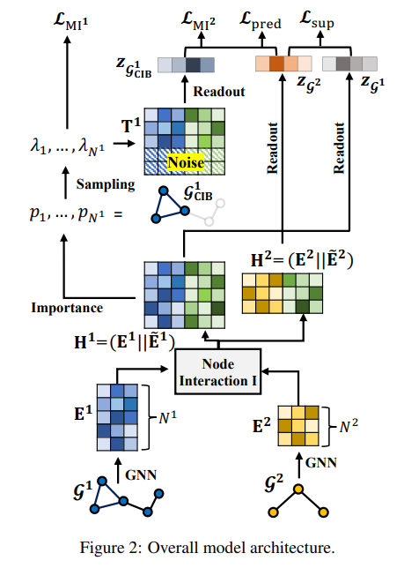
CGIB
First, they make interaction embedding
To encode two graph(solute, solvent), they set GNNs
For making interacted embedding
Measure similarity between nodes of two graph
Multiply similarity matrix with graph matrix

Slide 37
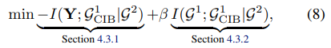
CGIB
Second, for extracting core graph and compressing un-core graph, they utilize information bottleneck principle.
For maximizing mutual information core graph under other graph they minimizing mutual information –I(Y; G1_cib|G2)
For minimizing un-core graph information they minimize I(G1,G1_cib|G2)

Slide 38
CGIB
Second, for extracting core graph and compressing un-core graph, they utilize information bottleneck principle.
For maximizing, minimizing mutual informations, there is need to determine what is core graph.
By injecting learnable noise into the representation they can determine what is core graph in the reaction. If node is in core graph, then they inject less noise for preserving information.

Slide 39
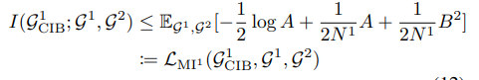
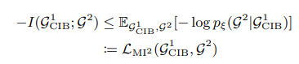
CGIB
Second, for extracting core graph and compressing un-core graph, they utilize information bottleneck principle.
In many case, measuring mutual information is intractable. For minimizing that, they set the upper-bound of the mutual information

Slide 40
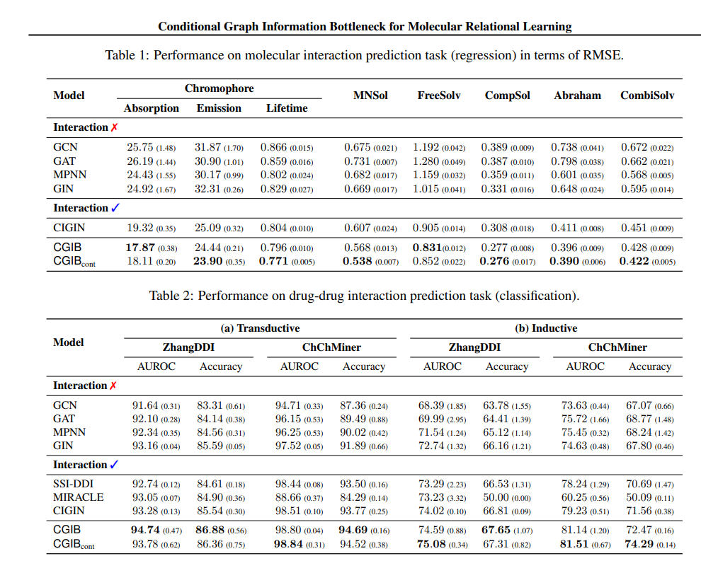
Experiment

Slide 41
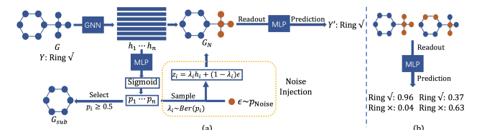
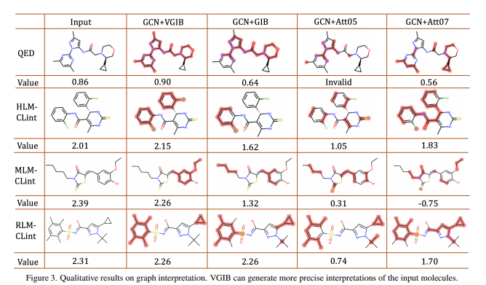

Slide 42
But in real world, Labeled molecular datasets are limited in availability
Even simple image classification task, at least a million labeled data is required
Unlike other domain(CV, NLP), process of labeling on chemistry require real chemical experiment and quantum chemistry calculations which are very time-consuming and capital-intensive
Directly training GNNs on small labeled molecule datasets in a supervised fashion is prone to over fitting and the trained GNNs can hardly generalize to out of distribution data

Slide 43
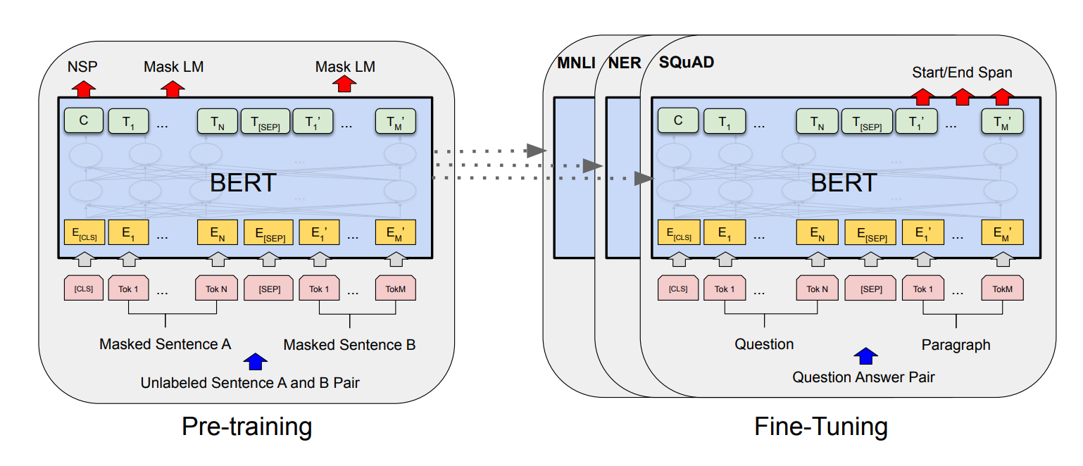
From a long time ago, NLP domain suffer same issue with molecular learning.
Lack of labeled data but abundant un-labeled data
They suggest “Pre-training” paradigm which is most dominant solution of these day AI
ChatGPT – GPT stand for “Generative Pre-trained Transformer model”
Not predict label of data, but predict masking word that we masked
After “Pre-training” then do “Fine-tuning”

Slide 44
The fundamental idea of “pre-training” is “there are transfer knowledge between pre-training task and down-stream task.
Predicting masked word has universal information in NLP domain task
Similar with NLP, molecular learning also do masking
Node(Atom) level masking
Subgraph(functional group, motif .etc) level masking
And MORE
Graph level Pretext Task
Predict MolMR, MolWt, LogP
3D level Pretext Task
Predict 3D structure when only 2D topology structure is given

Slide 45
MORE!!!!!!!!!!!!!!!!!!!!!!!!!!!!!!!!!!!!!!!!!!!!!!!!!!

Slide 46
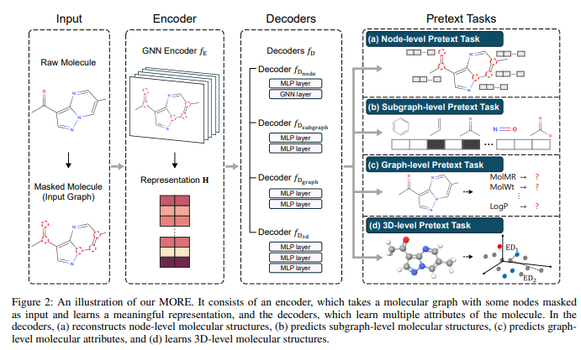
MORE: Molecule Pretraining with Multi-Level Pretext Task

Slide 47


Slide 48
QA

